Slide 1
Interactive Game Theory Webapp
Shreya Kumar

Slide 2
Project Description
Webapp that introduces user to concepts of game theory, then provides the user with multiple scenarios where they can interact with different options depending on the scenario
Explores concepts like Dominant Strategy, No sum and zero sum games within game theory
Provides user with applications of game theory within computer science and additional resources with more information

Slide 3
Features
Home/About Page
Types of “Games”
Scenarios
External Factors
Additional Sources

Slide 4
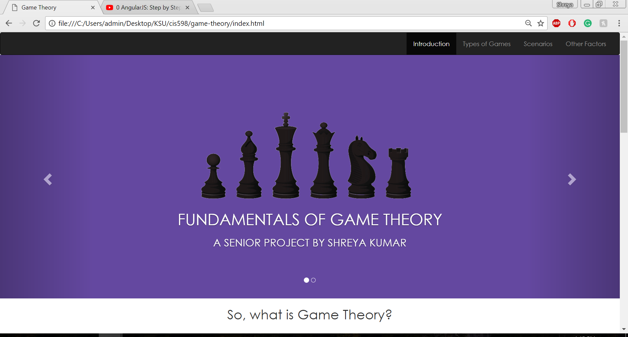
HOME Page

Slide 5
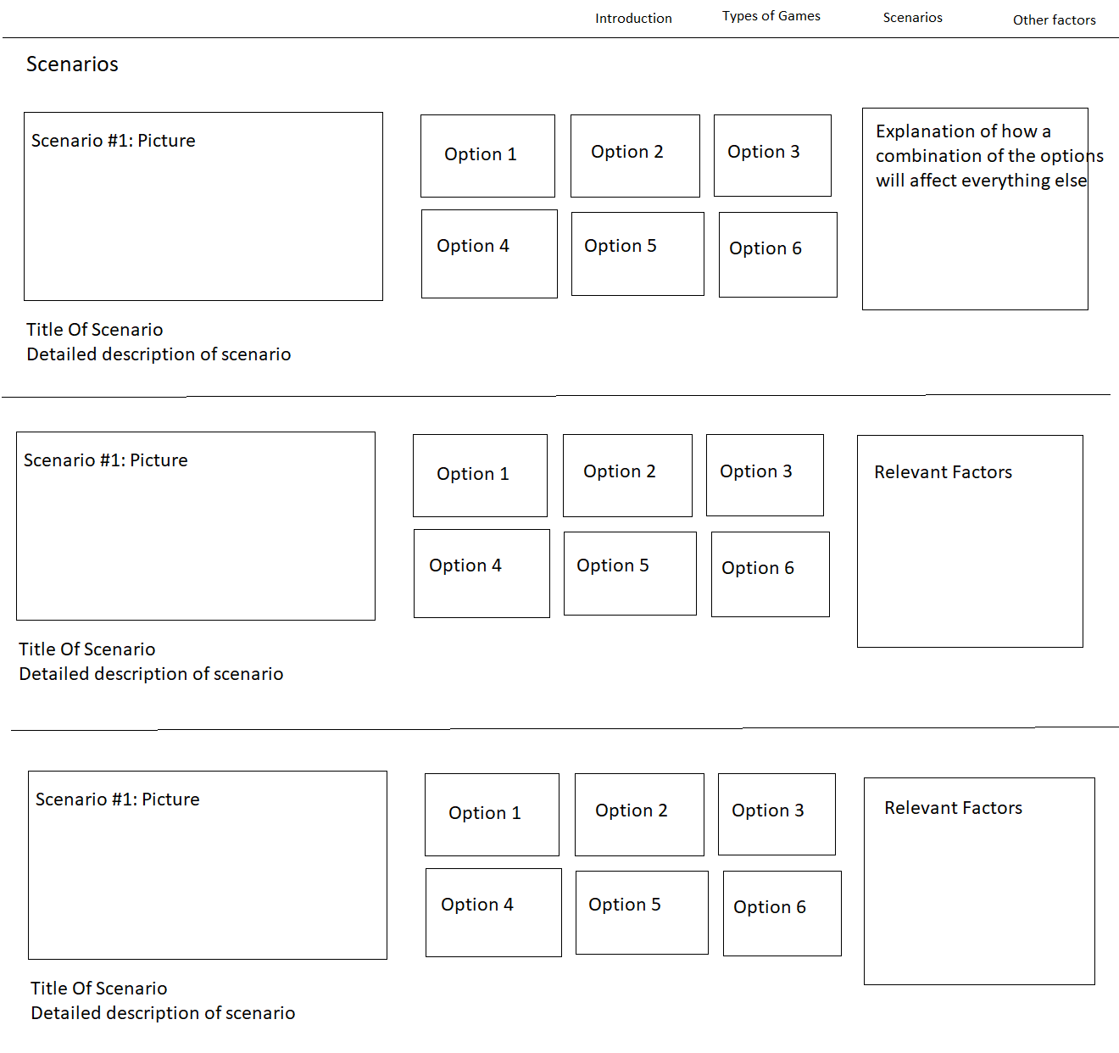
Mockup - Scenarios
Each option outlined in these scenarios is a different way to approach a game and when the user selects a particular options they get an explanation of how it would play out.
There will be about 5-6 scenarios including some well-known ones like the Prisoner's dilemma.
I will also be creating scenarios of my own to include in this page to give a variation in the difficulty of the scenarios listed

Slide 6
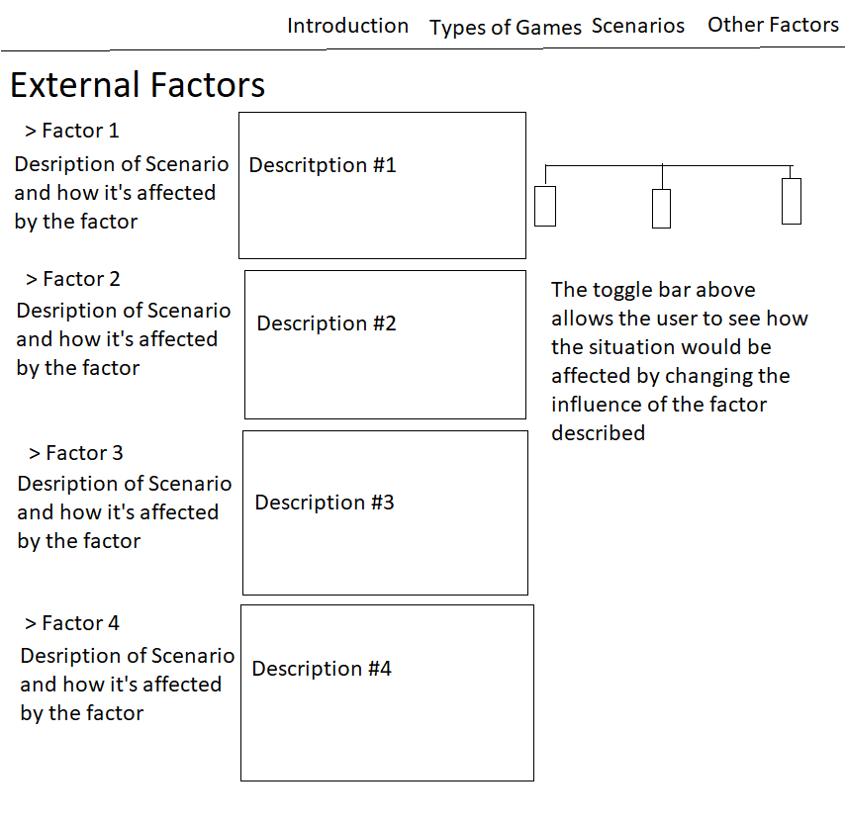
Mockup – External Factors
For each external factor shown in the page, there will be a toggle bar that the user than change to see how each situation will be affected with more/less influence of the external factor
For example if Factor 1 is information
There is a description of how having full and complete information changes the game for all players and the slider can be used to see how players can interact if there is perfect information, imperfect information or no information

Slide 7
Timeline
April 1-15
Write the scenarios (4-5)
This will be the mot important page of the project
April 15 – 30
Work on External Factors page
May 1-10
Testing
Bug fixes

Slide 8
Questions?

